Slide 1

Pros cons and challenges
Amplicons/marker genes/16S rRNA gene/microbiomics
Open & reproducible microbiome data analysis spring school
Wageningen, The Netherlands, May 28-30, 2018
Gerben DA Hermes, PhD
Laboratory of Microbiology,
Wageningen University & Research

Slide 2
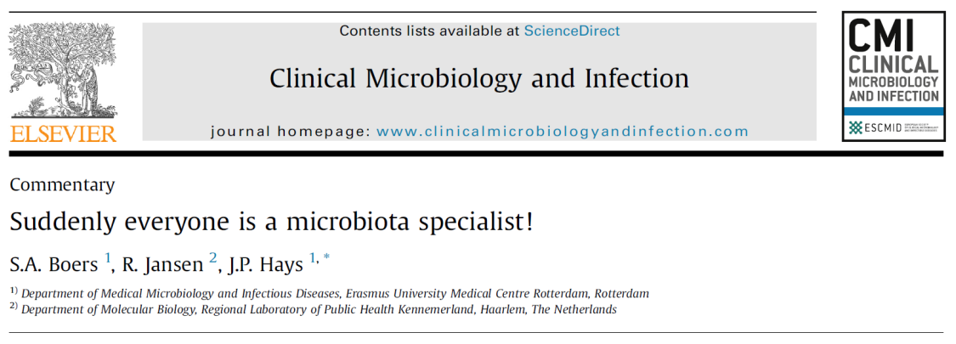
Some learning goals
Understand
Critical steps in sample prep & data analysis
Limitations (which conclusions can and can’t you draw)
Data (biological!) interpretation (day 2/3)
Interpret literature
sense & nonsense

Slide 3
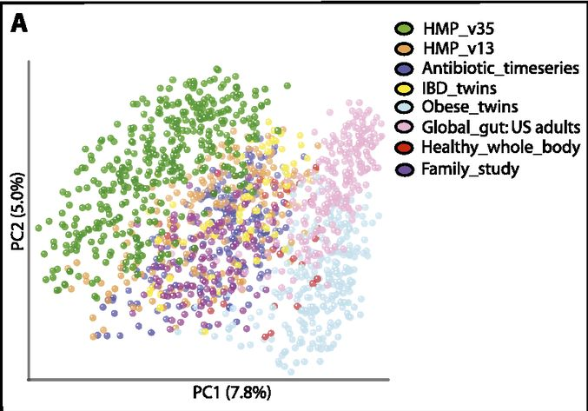
Literature & microbial biomarkers
Catherine A. Lozupone et al. Genome Res. 2013;23:1704-1714

Slide 4
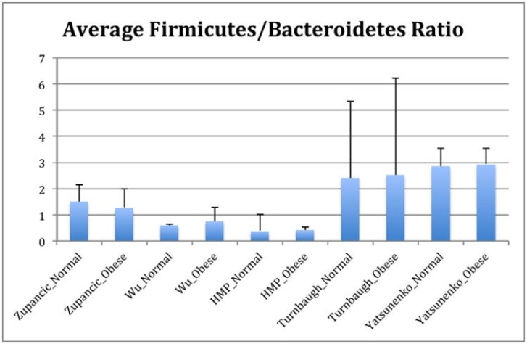
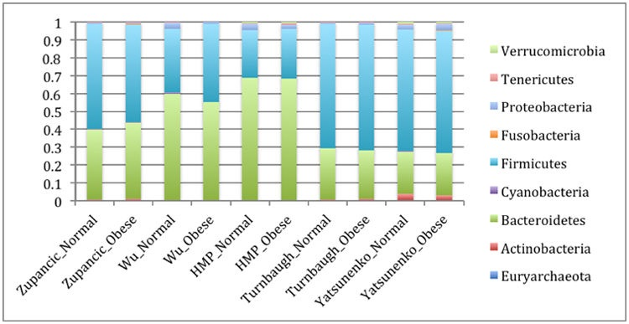
Microbial biomarkers for obesity
Walters et al. Meta-analyses of human gut microbes associated with obesity and IBD. FEBS Lett 2014

Slide 5
Before sample prep/data generation
How will you obtain fecal samples in your study?
What do you want to do with it?
Functional (transcriptome -> quenching)
Metabolome
In vitro fermentations
Freezing (how fast? What temperature? Freezer space)
Pre-label tubes

Slide 6
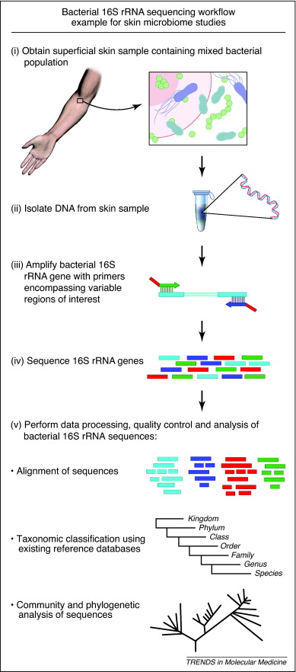
Typical amplicon sequencing workflow

Slide 7
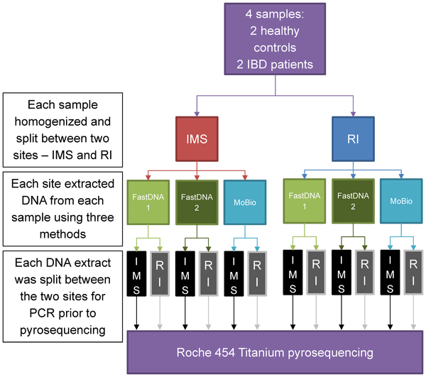
1. DNA isolation
Kennedy NA, Walker AW, Berry SH, Duncan SH, Farquarson FM, et al. (2014) The Impact of Different DNA Extraction Kits and Laboratories upon the Assessment of Human Gut Microbiota Composition by 16S rRNA Gene Sequencing. PLOS ONE 9(2): e88982. https://doi.org/10.1371/journal.pone.0088982
http://journals.plos.org/plosone/article?id=10.1371/journal.pone.0088982

Slide 8
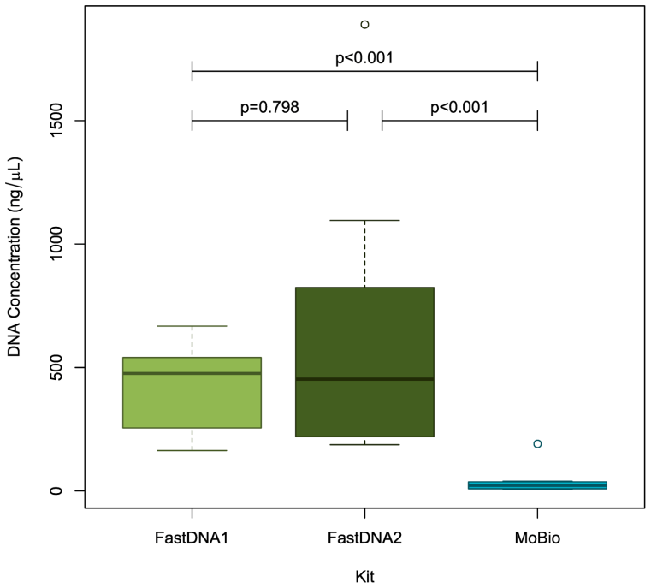
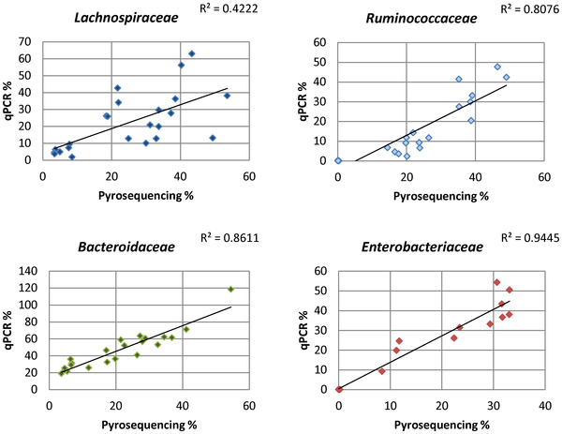
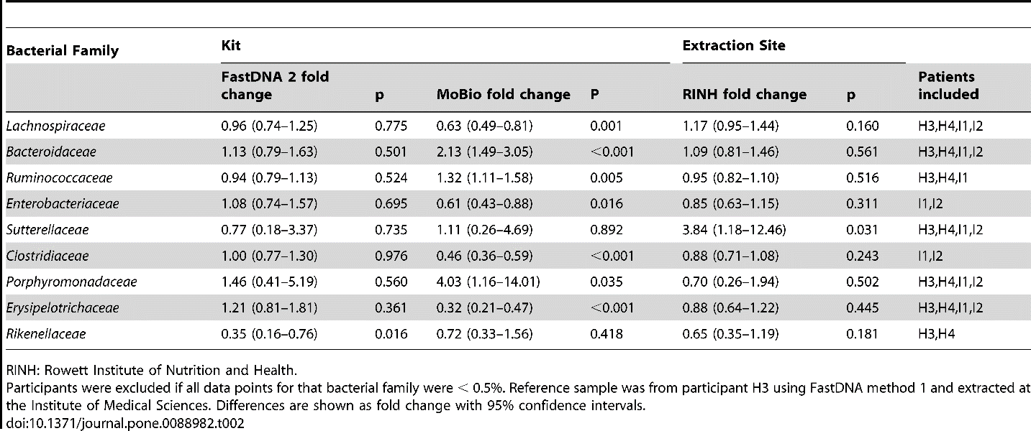

Slide 9
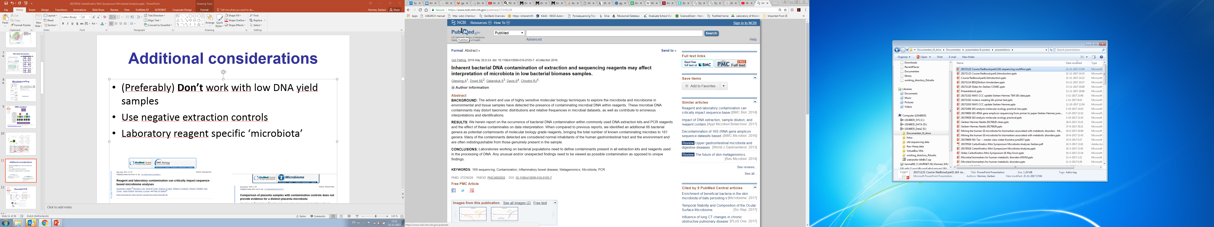
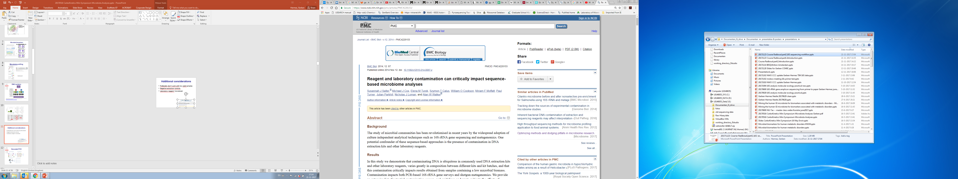
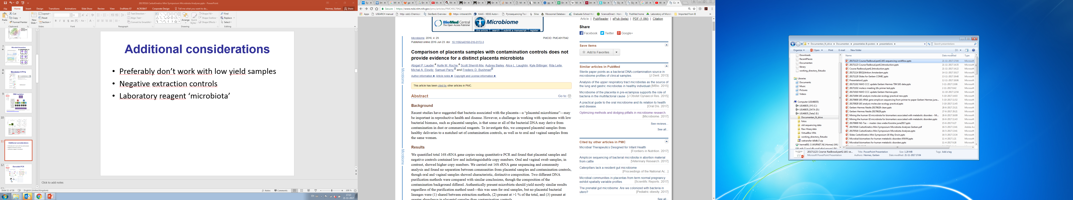
Additional considerations
(Preferably) Don’t work with low DNA yield samples
Can “contaminate” other samples
Use negative extraction controls
Laboratory reagent specific microbiota

Slide 10
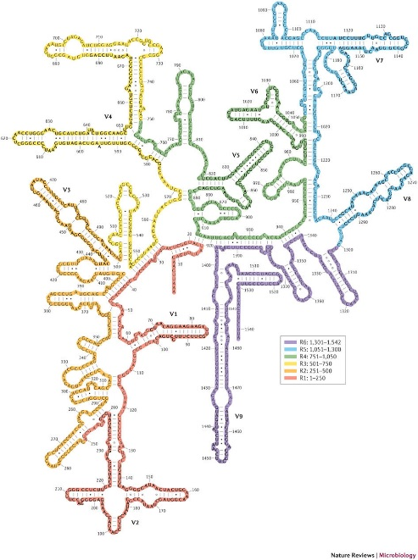
2. Barcoded PCR: Primers & Region: Coverage, Resolution, bias
16S rRNA gene
Target for detection & identification of bacteria.
Ideal phylogenetic marker.
Universally distributed, functionally constant,
Sufficiently conserved, no horizontal transfer (?)
More than 3,000,000 sequences in databases.
Alternating variable and conserved sequence domains.
variability
base position

Slide 11
2. Barcoded PCR: Primers In silico Coverage
Check for your ecosystem of interest
Americans didn’t have Bifidobacterium up to ~2006
No Verrucomicrobia in soil (actually 20%)

Slide 12
2. Barcoded PCR: Primers Resolution
Unequal sequence conservation
Be very careful with species level classification
Up to genus level identification is recommended!
variability
base position

Slide 13
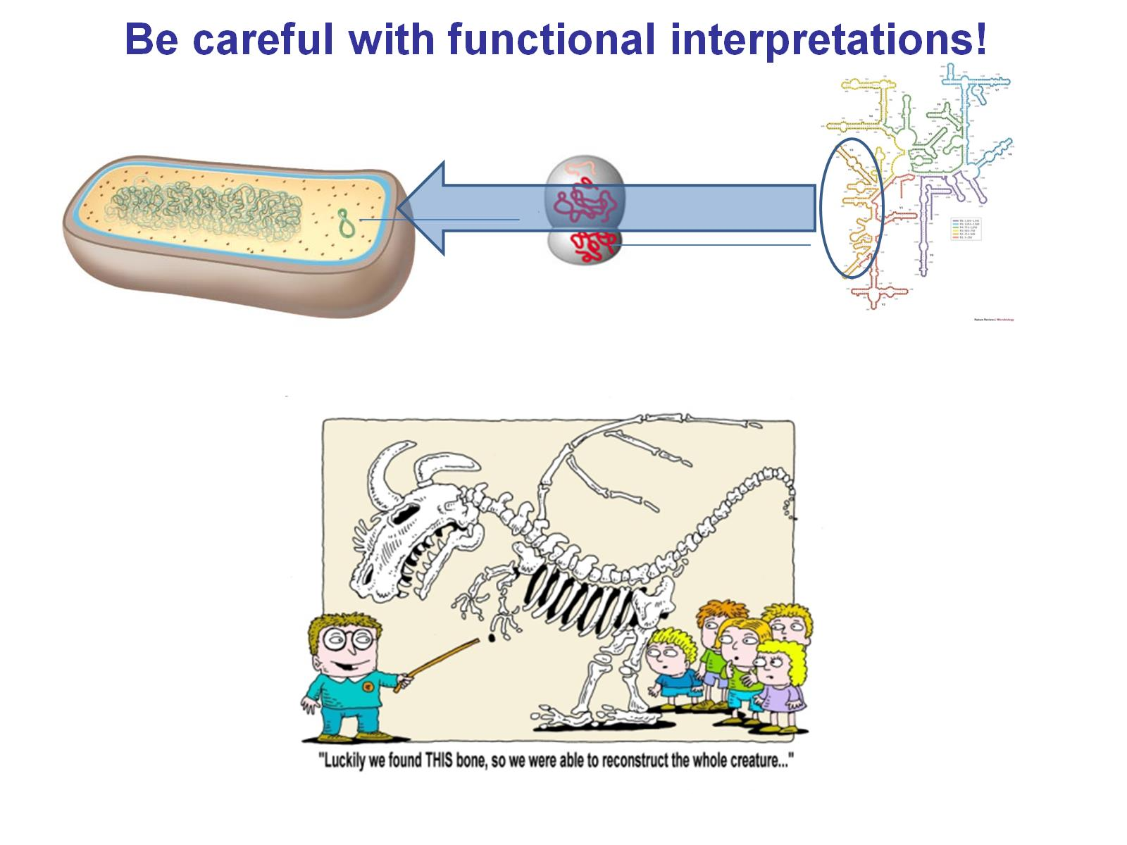

16S rRNA gene based approaches
Target for detection & identification of bacteria.
Ideal phylogenetic marker.
Universally distributed, functionally constant,
Sufficiently conserved, ‘no’ horizontal transfer (?)
More than 3,000,000 sequences in databases.
Alternating variable and conserved sequence domains.
variability
base position

Slide 14
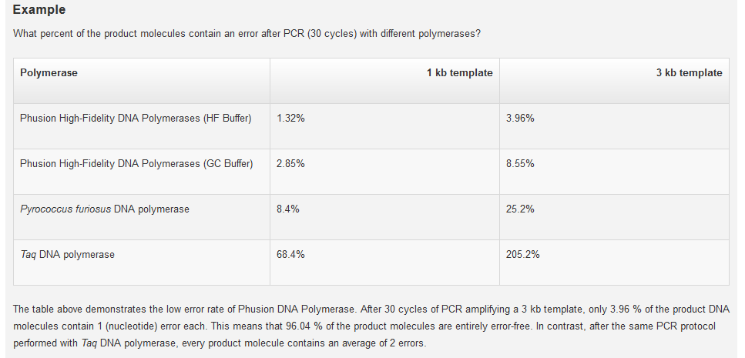
2. Barcoded PCR: Primers Bias
Polymerase
Primer-dimers
Amplification bias: sequence of the bacteria themselves (high GC)
Rate of chimera formation
Sequencing specific sequence specific error rates
Etc...

Slide 15
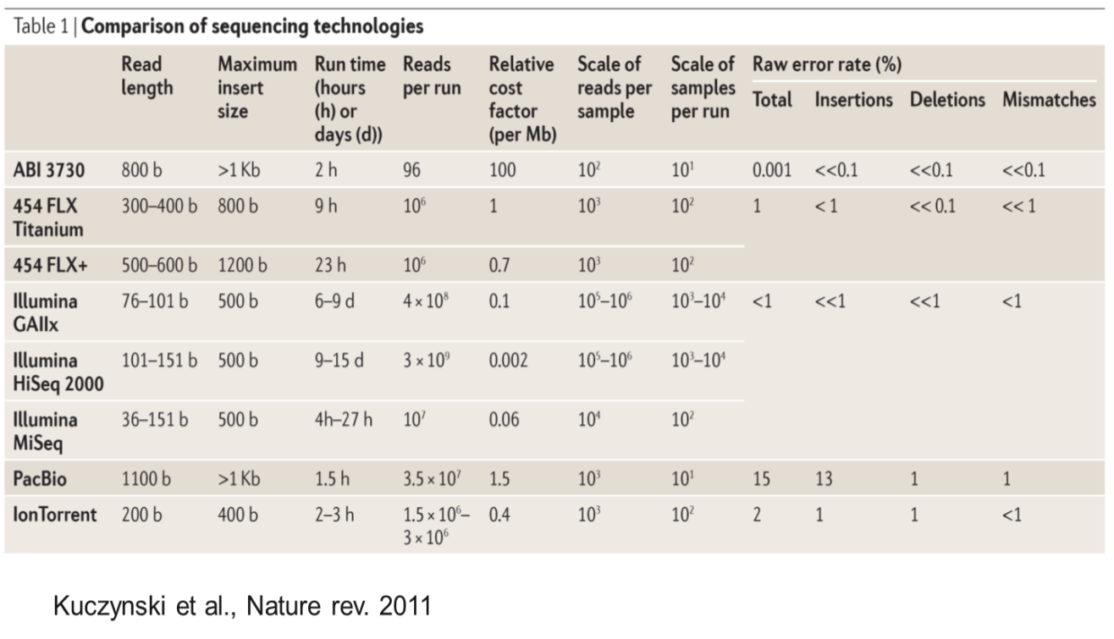
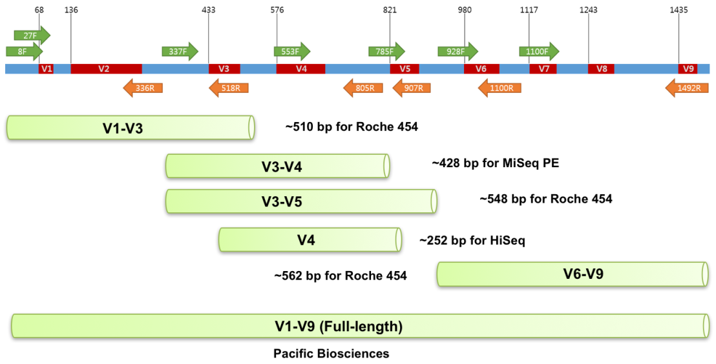
2. Barcoded PCR: Primers No universal primer (yet ?)

Slide 16
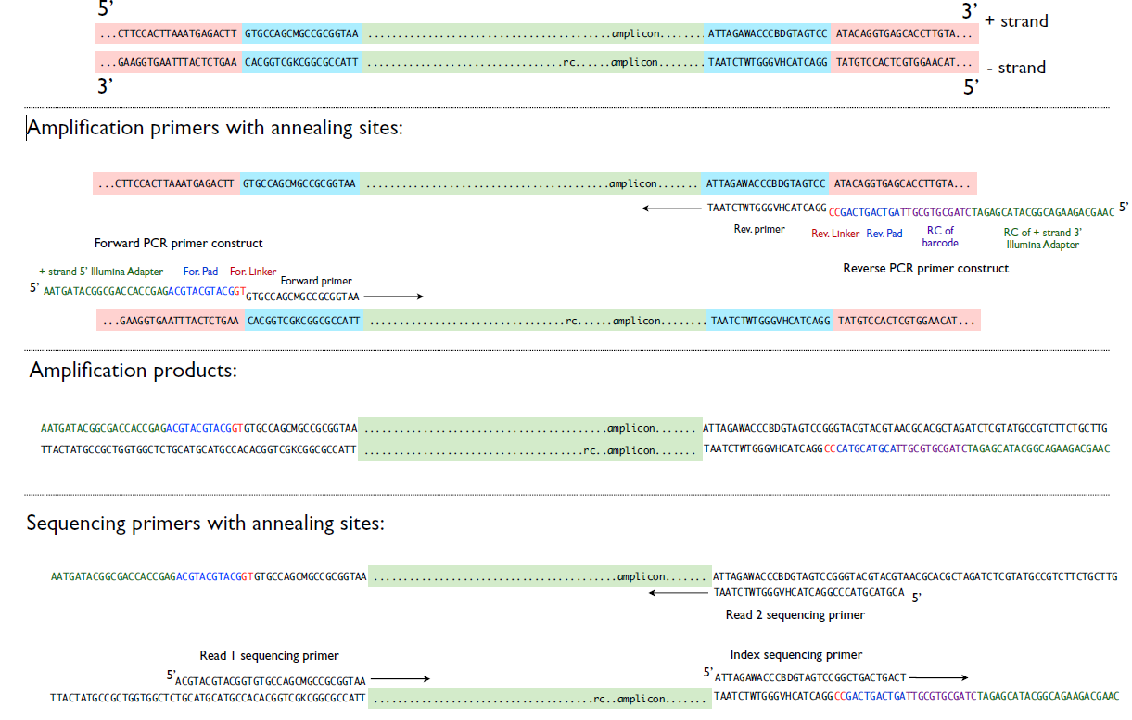
2. Barcoded PCR: barcoding strategy
Illumina Barcode
For. Linker
For. Barcode For. Primer
5’-
..…......amplicon…....
- 3’
~30nt
3’-
..…......amplicon.......
- 5’
Flowcell Adapter
Rev. Primer Rev. Barcode
Rev. Linker
~70-80nt

Slide 17
Analysis pipeline
CLC Genomics Workbench
QIIME
Mothur
DADA2
Etc.........
+ QC

Slide 18
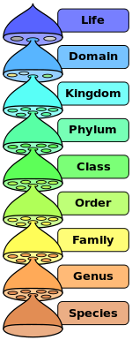
Analysis pipeline OTU picking
Operational Taxonomic Unit
traditionally clustered @ 97% -> ‘species’ proxy
Now : ‘sequences’
Summarize to genus level
~88%
~92%
~95%
Escherichia Coli & Salmonella >98% similar
Horizontal gene transfer
~97%

Slide 19
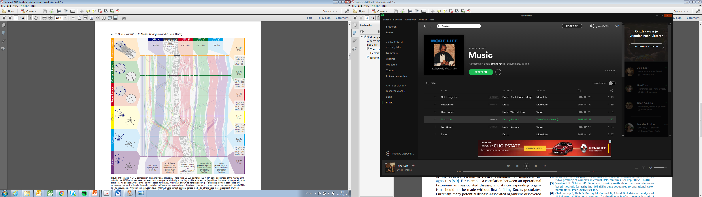
Analysis pipeline: OTU picking
De novo
Clustering (percentage threshold), 97%
Reference based
Match the reads to a 97% pre-clustered database
Unknown sequences ?
Schmidt et al 2014, Limits to robustness and reproducibility in the demarcation of operational taxonomic units. Env micr.

Slide 20
Analysis pipeline Taxonomic classification
Different methods of classification -> different name (scoring system)
BLAST
Kmer
MisMatches
16s rRNA gene Databases
Ribosomal Database Project (RDP-II)
Greengenes (13_05) (poor alignment/outdated)
SILVA

Slide 21
Challenges
Important!
Bias (might miss bacteria)
Can overshadow biology
Important!
Bias (eg. coverage, amplification bias)
Can overshadow biology
Important!
Bias (Sequencing error (type and machine specific))
Important!
Bias (OTU clustering)
Important!
Bias (classifier and database (different names))
The hard part

Slide 22
Effects of all these different parameters in literature
Catherine A. Lozupone et al. Genome Res. 2013;23:1704-1714

Slide 23
Microbial biomarkers
Walters et al. Meta-analyses of human gut microbes associated with obesity and IBD. FEBS Lett 2014

Slide 24
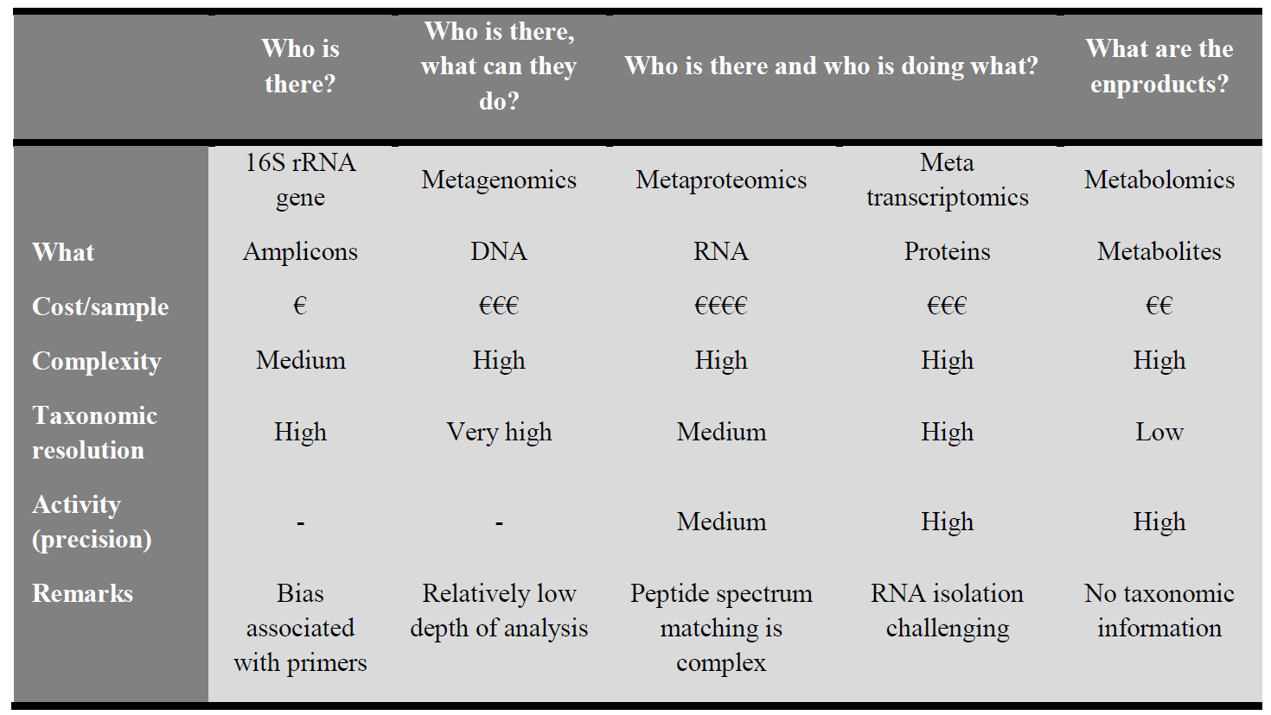
Pros & cons

Slide 25
Keep in mind/challenges/interpretation
OTUs
Prokaryotic species level boundary is still hotly debated
Species level concept for organisms with mobile genetic elements....
Function & 16S are ‘only’ correlated (sometimes actually not that much)
E coli: probiotic (nissle), pathogen (O157:H7 acute haemorrhagic colitis, Shiga-toxin) & everything in between (K12)
Most bacteria are opportunists

Slide 26
Recap

